Slide 1
Machine Learning in NLP
Building Transformer-Based Natural Language Processing Applications (Part 1)

Slide 2
FULL COURSE AGENDA
Part 1: Machine Learning in NLP Lecture: NLP background and the role of DNNs leading to the Transformer architecture Lab: Tutorial-style exploration of a translation task using the Transformer architecture
Part 2: Self-Supervision, BERT, and Beyond Lecture: Discussion of how language models with self-supervision have moved beyond the basic Transformer to BERT and ever larger models Lab: Practical hands-on guide to the NVIDIA NeMo API and exercises to build a text classification task and a named entity recognition task using BERT-based language models
Part 3: Production Deployment Lecture: Discussion of production deployment considerations and NVIDIA Triton Inference Server Lab: Hands-on deployment of an example question answering task to NVIDIA Triton
Notes:
The course has three parts. This is part 1, “Machine Learning in NLP”.

Slide 3
Part 1: Machine Learning in NLP
Lecture
What is NLP?
Why Machine Learning?
Text Representations
Dimensionality Reduction
Embeddings
RNNs
“Attention is All You Need”
Lab
Transformer Architecture
Transformer Encoder
Transformer Decoder
Notes:
In this part, there will both a lecture and a hands-on lab section. In the lecture we’ll cover these topics. The goal of this lecture is to provide a good overview of NLP tasks, and the technologies to date (briefly) that have led us to the Transformer architecture, which was presented in the now-famous Google paper, “Attention is All You Need”.

Slide 4
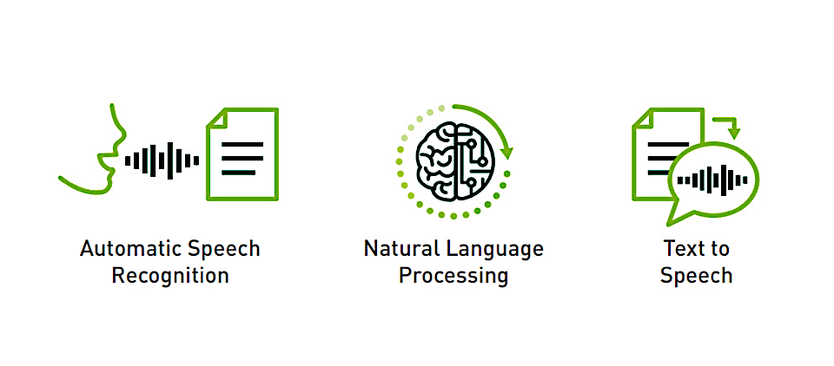
Conversational ai technologies
Notes:
In the context of “Conversational AI”, which includes voice assistants and so on, the NLP, or Natural Language Processing part of the pipeline is the “brains” of the operation, in the context of the general AI idea. For our purposes, we will simply forget about ASR and TTS for now. All of our tasks will focus on text in and text out problems.

Slide 5








NLP tasks
“Tasks” refer to specific textual language applications
Machine Translation | Sentiment Analysis | Question Answering | Automatic Text Summarization
Author Attribution | Named Entity Recognition | Text Classification | Spell Checking
?
?
?
?
And many more!

Slide 6
Part 1: Machine Learning in NLP
Lecture
What is NLP?
Why Machine Learning?
Text Representations
Dimensionality Reduction
Embeddings
RNNs
“Attention is All You Need”
Lab
Transformer Architecture
Transformer Encoder
Transformer Decoder
Notes:
In this part, there will both a lecture and a hands-on lab section. In the lecture we’ll cover these topics. The goal of this lecture is to provide a good overview of NLP tasks, and the technologies to date (briefly) that have led us to the Transformer architecture, which was presented in the now-famous Google paper, “Attention is All You Need”.

Slide 7
The Challenge
Complexity of human language
Languages often seem to behave in arbitrary ways and forms
Ambiguity, sarcasm and irony are often not apparent from purely textual information
Domain-specific terms and phrases that may not even be grammatically correct
Notes:
Dealing with natural language in an algorithmic fashion often poses a number of tough issues:
The grammar and rules of languages often seem arbitrary and random. Consider, for example, the plural form of the word cat vs. that of the word cab. The former is pronounced cats while the latter is pronounced cabz. How then should a speech-to-text system handle plural forms?
Many uses of language depend on the context of a conversation and/or on auditory cues such as stress on a particular word or syllable. Consider ‘would you like this apple?’ vs. ‘would you like this apple?’, where the emphasis is on the bold word. Without these auditory cues and the context, how would an automated system know what the meaning of the sentence is?
Many domains use specific terminology that may not be immediately understood or may even be flat-out grammatically incorrect. Consider the financial term ‘to short a stock’. The meaning is obvious to someone well-versed in the stock market but not so to the layperson. In particular, note that short would normally be considered an adjective while here it is used as a verb. Another example would be ‘my ask of you is …’, where ask – normally a verb – is used as a noun. How can a system differentiate a domain-specific meaning from a grammatical mistake?
Fortunately, Deep Learning can help us. It is meant precisely for these kinds of situations: many ill-defined rules that a human would have a very hard time formulating. Combine this with the fact that massive amounts of textual data are available today in the form of emails, social media posts and articles, and we have a very promising approach for the application of NLP techniques.

Slide 8
Principles And Parameters
Linguistic Concept
Framework created by linguists Noam Chomsky and Howard Lasnik
The framework states that languages are composed of ‘hard-wired’ principles and language-specific instantiations
In software terms: A ‘language’ is an object, with different implementations of virtual functions. We compute a binary value – whether a sentence is grammatical or not – by running it through a language-specific Chain-of-Responsibility structure
Notes:
One of the major contributions of Noam Chomsky (along with another well-known linguist Howard Lasnik) is the theory of ‘Principles and Parameters’. Although it has since been superseded by a different theory, the core ideas are very similar. Basically, Chomsky and Lasnik argue that humans are born with a hard-wired set of rules – known as Universal Grammar or UG – that define the properties of each language. Each language ‘chooses’ the values that apply to each such rule, as well as the priorities of these rules. Of course, the discussion in linguistic circles center around what the rules are and what values are permissible.
This view of languages maps quite nicely to Object-Oriented Programming - a single language can be thought of as an object that implements (i.e., overrides) a number of abstract methods. We then decide whether a given sentence is a valid utterance in that language – a concept we call ‘grammaticality’ – by choosing the order in which we evaluate these methods. We can implement this using the Gang-of-Four Design Pattern known as ‘Chain of Responsibility’.

Slide 9
Principles and Parameters
Example: Word Order
English: John ate apples
Japanese: Jon wa ringo o tabeta
John apple ate
Notes:
The canonical example of how languages differ from each other is in how they order their words. Here you can see a simple sentences – consisting of a subject, a verb and a direct object – in two languages that have different word order.
English is a Subject-Verb-Object (SVO) language. These account for 42% of the world’s known languages.
Japanese, on the other hand, is a Subject-Object-Verb (SOV) language. These contain 45% of the world’s known languages.
There are 6 ways to order 3 distinct objects (i.e., permutations). We have seen two here. There are languages for each one of the other 4 ways to order subject, object and verb. However, they make up a small percentage of the world’s languages.
Japanese is presented in its accepted transliteration into English. The italic text below the transliteration, known as ‘gloss’, shows the translation of each word. For clarity, we have omitted the translation of wa and o, as they do not affect word order.
In software terms, we see word order as an abstract function returning a value from a closed set of possible options, otherwise known as an enumeration.

Slide 10
Principles and Parameters
Example: Null Subject
English: It is raining
Spanish: Está lloviendo
is raining
What is the role of ‘It’ in English?
Notes:
In this example, we see a Principle named Null Subject, and the way it is ‘implemented’ in two languages.
In the English example, we see the pronoun it. We previously saw that pronouns refer to a noun. An interesting question here is what does it refer to? It is especially interesting when compared to the Spanish example, where there is no pronoun.
‘It’ in English is known as an ‘expletive’. It specifically does not refer to any noun. Rather, it is there only because English is not a Null Subject language and must have something in the subject position in the sentence. Spanish, on the other hand, is a Null Subject language – we can imagine the sentence to have a Null value in the subject position.
We see the software concept of Null, as well as how two different languages override an abstract Null Subject method/function.

Slide 11
Syntactic ambiguity
Linguistic Concept
John and Henry’s parents arrived at the house.
How many people arrived in total?
Notes:
In this example, we see a case of syntactic ambiguity. In essence, the question is what the relationship between the parents and John and Henry.
The following are possible interpretations:
John, Henry and Henry’s parents arrived (4 people)
John and Henry’s parents arrived (3 people)
John and Henry’s common parents arrived (2 people)
So the ambiguity lies in where the possessive marker ‘attaches’ to the sentence (which makes it an issue of syntax). We would normally need more context to be able to disambiguate this sentence and get the proper interpretation.
In software terms, we have a function that returns a list (or array) of values, which are then processed somewhere else. The outputs in this case would be the list [2,3,4].

Slide 12
The Challenge
When viewed through the eyes of a linguist
Languages obeys strict rules and generalizations
These generalizations map nicely to software constructs that are very helpful when we design NLP systems
The huge mass of textual data available today means that Machine Learning is an ideal approach for NLP

Slide 13
Problem Formulation
Notes:
To put it in perspective

Slide 14
Machine Learning
Discovering the discussed structures in text
Machine Learning Algorithm
Text

Slide 15
Machine Learning
Discovering the discussed structures in text
?
Machine Learning Algorithm
Text

Slide 16
Machine Learning
Design decisions
?
Problem formulation
?
?
?
?
?
?
Machine Learning Algorithm
Text Pre-processing
Text Representation
Reweighting
Dimensionality Reduction
Vector Comparison
Text

Slide 17
Machine Learning
All linear combinations feasible
?
Problem formulation
?
?
?
?
?
?
Machine Learning Algorithm
Text Pre-processing
Text Representation
Reweighting
Dimensionality Reduction
Vector Comparison
Text
GloVe
Word2Vec

Slide 18
Machine Learning
In this class
Subset of Problem formulations
Machine Learning Algorithm
Text Pre-processing
Text Representation
Reweighting
Dimensionality Reduction
Vector Comparison
Text
Subset of
approaches
Subset of word representations

Slide 19
Part 1: Machine Learning in NLP
Lecture
What is NLP?
Why Machine Learning?
Text Representations
Dimensionality Reduction
Embeddings
RNNs
“Attention is All You Need”
Lab
Transformer Architecture
Transformer Encoder
Transformer Decoder
Notes:
In this part, there will both a lecture and a hands-on lab section. In the lecture we’ll cover these topics. The goal of this lecture is to provide a good overview of NLP tasks, and the technologies to date (briefly) that have led us to the Transformer architecture, which was presented in the now-famous Google paper, “Attention is All You Need”.

Slide 20
Text Representations
The bag of words
Bag of words/ngrams – feature per word/ngram
the cat sat on the mat
Various ways of choosing the values: Binary, Count, TF-IDF
cat | sat | on | the | mat | quickly
1 | 1 | 1 | 2 | 1 | 0
… |Vocabulary|

Slide 21
The Bag of words
Key challenges
Sparse Input (1-hot)
No semantic generalization
dog: 1 0 0 0 0 … 0
cat: 0 0 1 0 0 … 0
p >> n (overfitting!)
…
…
…
Word 1
Word n
Word 1
Word n
lots of data required,
low accuracy
Notes:
There are several issues with the BoW representation:
Sparse Input – As we saw in the previous example, each word is a feature. Hence, when providing this data to a model, we need to let it know that we mean feature number 1 in the BoW table which is cat, and not feature number 2 which is dog. We do this by performing a 1-hot encoding on the numbers: we create a vector with the size of the entire vocabulary. We then give the index we want the value 1 while all others are given the value 0. So cat will be the vector (1,0,0,…,|V|), dog will be (0,1,0,0,…,|V|), etc. For a large vocabulary (i.e., |V| is large) this means that much of the input data will be sparse – that is, have the value 0. The impact of sparseness is that the number of features (words) will potentially be much larger than the number of examples we have which will almost certainly lead to overfitting.
No semantic generalization – In this example, dog is feature #1 while cat is #2. Note that this is completely arbitrary. In particular, this means that we cannot generalize. In other words, the model is unable to apply knowledge that it learned about cats to dogs as it is completely unaware that the two are related (both are animals, have 4 legs and a tail, etc.). Ideally we would have liked a model that deals with animals to understand the similarities as well as the differences between animals before it dealt with our specific task. Putting it somewhat figuratively, we would have liked the model to show some innate intelligence.

Slide 22
Distributed Word Representations
Notes:
To put it in perspective

Slide 23
Distributional Hypothesis
The intuition
‘You can tell a word by the company it keeps’
Firth 1957
‘Distributional statements can cover all of the material of a language without requiring support from other types of information’
Harris 1954
‘The meaning of a word is its use in the language’
Wittgenstein 1953
‘The complete meaning of a word is always contextual, and no study of meaning apart from context can be taken seriously.’
Firth 1957

Slide 24
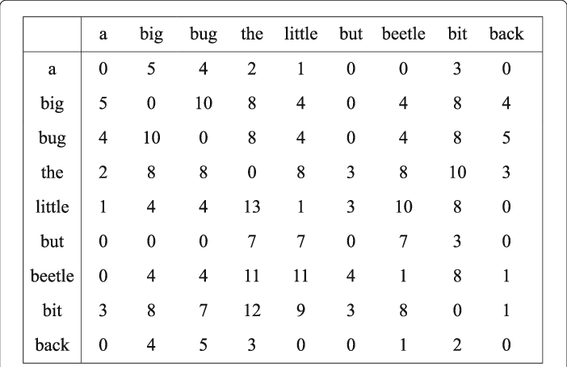
Co-occurrence patterns
The latent information

Slide 25
Co-occurrence patterns
The latent information
The cat sat on the mat
The dog sat on the mat
The elephant sat on the mat
The quickly sat on the mat
Notes:
In this example, given a set of context words that appear before and after a target word (colored in either green or red), we see that the appropriate target words are all animals. Obviously, the word quickly does not fit into the context, primarily because it is an adverb while the context stipulates a noun (or a phrase that acts as a noun, aptly named a noun phrase). However, the word pen – which is a noun – would also not be appropriate in this context. This time the reason is semantic rather than syntactic – and it is this property of the DH that we would like to exploit in giving our input representation a-priori ‘intelligence’.

Slide 26
Co-occurrence patterns
Where to find them?
Possible relationships:
Word to documents (very sparse and very wide)
Word to word (very dense and compact)
Word to user / person
Word to user behaviour
Word to product
Word to custom feature (e.g. movie raking)
Not only metrices:
Word to user to product

Slide 27
Part 1: Machine Learning in NLP
Lecture
What is NLP?
Why Machine Learning?
Text Representations
Dimensionality Reduction
Embeddings
RNNs
“Attention is All You Need”
Lab
Transformer Architecture
Transformer Encoder
Transformer Decoder
Notes:
In this part, there will both a lecture and a hands-on lab section. In the lecture we’ll cover these topics. The goal of this lecture is to provide a good overview of NLP tasks, and the technologies to date (briefly) that have led us to the Transformer architecture, which was presented in the now-famous Google paper, “Attention is All You Need”.

Slide 28
Dimensionality Reduction
Rationale
The need for compact and computationally efficient representations
More robust notions of distance exposing the information captured by our distributional representation

Slide 29
LSA
Notes:
To put it in perspective

Slide 30
LSA
Latent Semantic Analysis
?

Slide 31
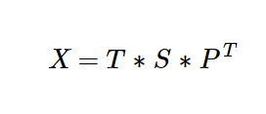
LSA
Truncated SVD
Terms x Documents
Susan T. Dumais (2005). "Latent Semantic Analysis". Annual Review of Information Science and Technology. 38: 188–230.

Slide 32
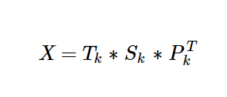
LSA
Truncated SVD
Terms x Documents
K largest singular values
Susan T. Dumais (2005). "Latent Semantic Analysis". Annual Review of Information Science and Technology. 38: 188–230.

Slide 33
LSA
Truncated SVD
Terms x Documents
K largest singular values
Latent Semantic Space
Susan T. Dumais (2005). "Latent Semantic Analysis". Annual Review of Information Science and Technology. 38: 188–230.

Slide 34
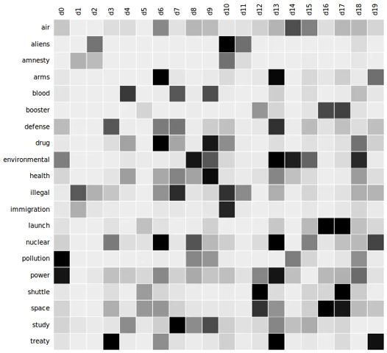
LSA
Example
https://en.wikipedia.org/wiki/Latent_semantic_analysis

Slide 35
LSA
Question
What about large matrices?
What about complex corpora?

Slide 36
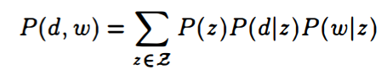
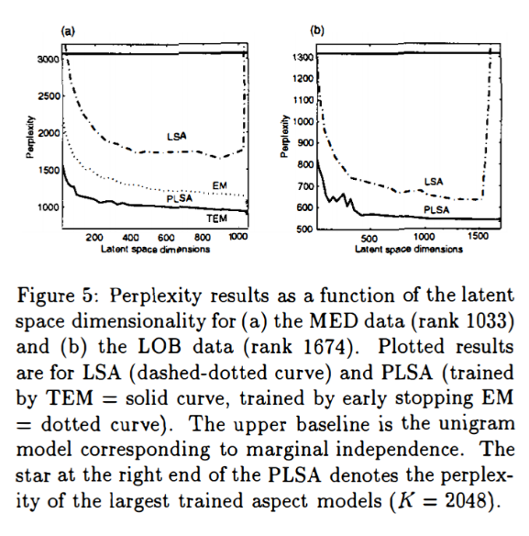
Probabilistic LSA
Statistical model which has been called aspect model
Hofmann, T. (2013). Probabilistic latent semantic analysis. arXiv preprint arXiv:1301.6705.

Slide 37
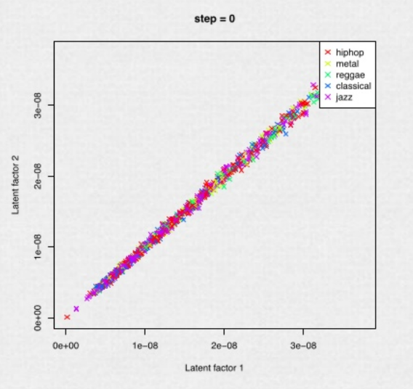
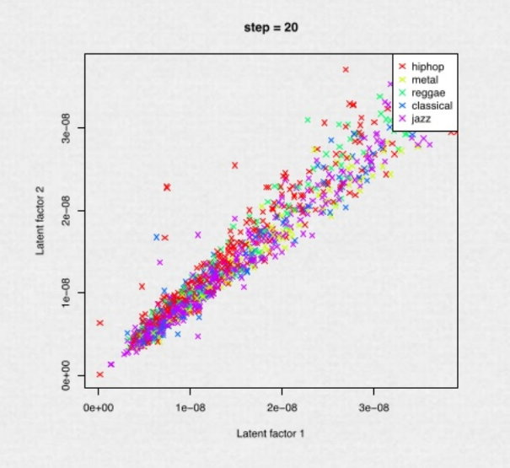
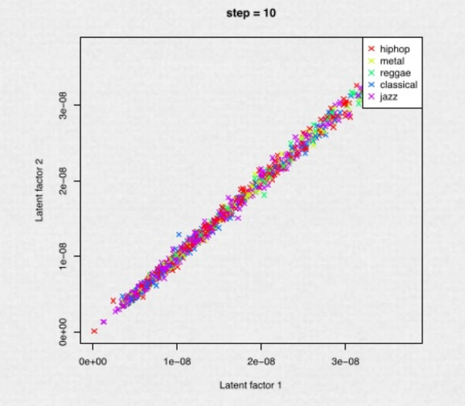
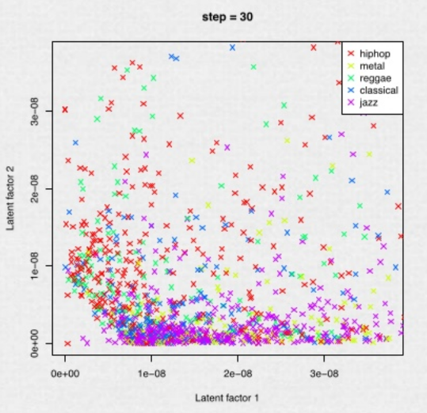
Probabilistic LSA
Very broadly used (Spotify Example)
https://www.slideshare.net/erikbern/collaborative-filtering-at-spotify-16182818

Slide 38
LDA
Notes:
To put it in perspective

Slide 39
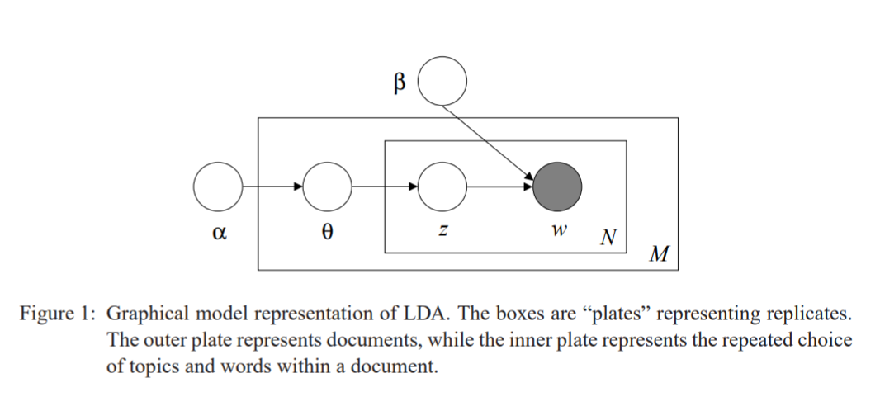
LDA
Latent Dirichlet Allocation
Blei, David M.; Ng, Andrew Y.; Jordan, Michael I (January 2003). Lafferty, John (ed.). "Latent Dirichlet Allocation". Journal of Machine Learning Research. 3 (4–5): pp. 993–1022. doi:10.1162/jmlr.2003.3.4-5.993. Archived from the originalon 2012-05-01. Retrieved 2006-12-19.

Slide 40
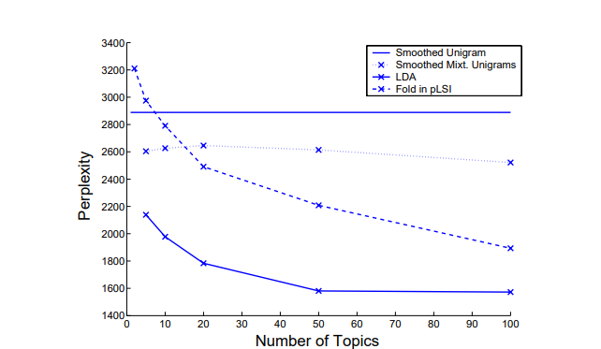
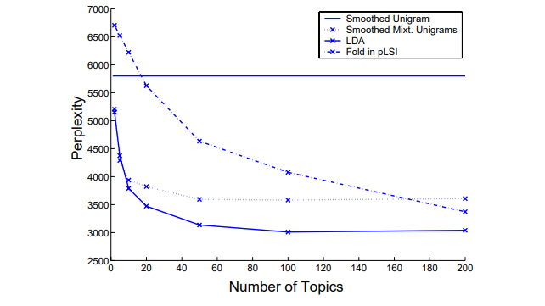
LDA
Latent Dirichlet Allocation
Perplexity results on the nematode (Left) and AP (Right) corpora for LDA, the unigram model, mixture of unigrams, and pLSI.
Blei, David M.; Ng, Andrew Y.; Jordan, Michael I (January 2003). Lafferty, John (ed.). "Latent Dirichlet Allocation". Journal of Machine Learning Research. 3 (4–5): pp. 993–1022. doi:10.1162/jmlr.2003.3.4-5.993. Archived from the originalon 2012-05-01. Retrieved 2006-12-19.

Slide 41
Autoencoders for Dimensionality Reduction
Notes:
To put it in perspective

Slide 42
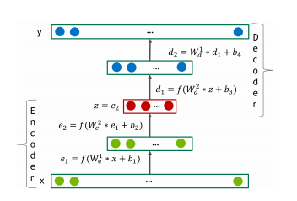
Autoencoders
Where to find them?
“An autoencoder is a type of artificial neural network used to learn efficient data codings in an unsupervised manner.”
Kramer, 1991

Slide 43
Part 1: Machine Learning in NLP
Lecture
What is NLP?
Why Machine Learning?
Text Representations
Dimensionality Reduction
Embeddings
RNNs
“Attention is All You Need”
Lab
Transformer Architecture
Transformer Encoder
Transformer Decoder
Notes:
In this part, there will both a lecture and a hands-on lab section. In the lecture we’ll cover these topics. The goal of this lecture is to provide a good overview of NLP tasks, and the technologies to date (briefly) that have led us to the Transformer architecture, which was presented in the now-famous Google paper, “Attention is All You Need”.

Slide 44
Word2Vec
Notes:
To put it in perspective

Slide 45
Word2Vec
Mikolov et al., 2013 (while at Google)
Linear model (trains quickly)
Two models for training embeddings in an unsupervised manner:
Continuous Bag-of-Words (CBOW)
Skip-Gram
cat
PAD
the
sat
on
1-hot (|V|)
1-hot (|V|)
d-dimensional
Σ
d-dimensional
d-dimensional
E
E
E
E
E
E
E
E
d-dimensional
1-hot (|V|)
1-hot (|V|)
cat
cat
cat
cat
PAD
the
sat
on
Notes:
The main question now is how to implement an algorithm that generates word embeddings. There are multiple such algorithms. In this lab, you will work primarily with the Word2Vec algorithm that was invented by Mikolov et al. while at Google.
Word2Vec has two variants:
Continuous Bag-of-Words (CBOW): In this variant, using a number of context words, we try to predict the target word. Notice that by summing the embedding vectors we lose the word order, hence the BoW name.
Skip-Gram: In this variant we use the target word to predict each of the context words.
Note the words marked PAD – these are padding markers, signifying that there are no actual words here. Essentially, these are NULL markers for denoting empty context words.
A key property of the Word2Vec algorithm is that it is unsupervised (or more precisely, self-supervised). This means that it can be trained with huge corpora and generate very useful embedding vectors.

Slide 46
Glove
Notes:
To put it in perspective

Slide 47
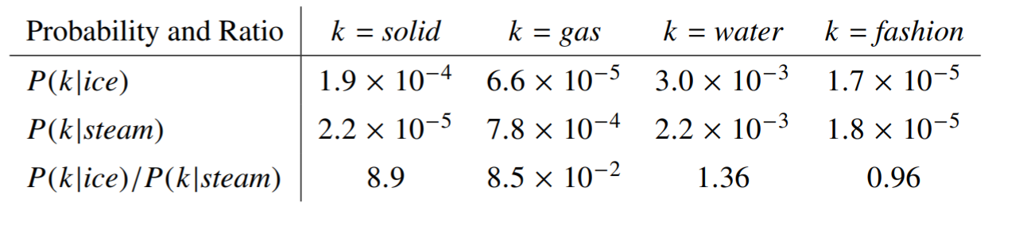
Glove
The objective
To learn vectors for words such that their dot product is proportional to their probability of co-occurence
Pennington, J., Socher, R., & Manning, C. D. (2014, October). Glove: Global vectors for word representation. In Proceedings of the 2014 conference on empirical methods in natural language processing (EMNLP) (pp. 1532-1543).
Notes:
The main question now is how to implement an algorithm that generates word embeddings. There are multiple such algorithms. In this lab, you will work primarily with the Word2Vec algorithm that was invented by Mikolov et al. while at Google.
Word2Vec has two variants:
Continuous Bag-of-Words (CBOW): In this variant, using a number of context words, we try to predict the target word. Notice that by summing the embedding vectors we lose the word order, hence the BoW name.
Skip-Gram: In this variant we use the target word to predict each of the context words.
Note the words marked PAD – these are padding markers, signifying that there are no actual words here. Essentially, these are NULL markers for denoting empty context words.
A key property of the Word2Vec algorithm is that it is unsupervised (or more precisely, self-supervised). This means that it can be trained with huge corpora and generate very useful embedding vectors.

Slide 48
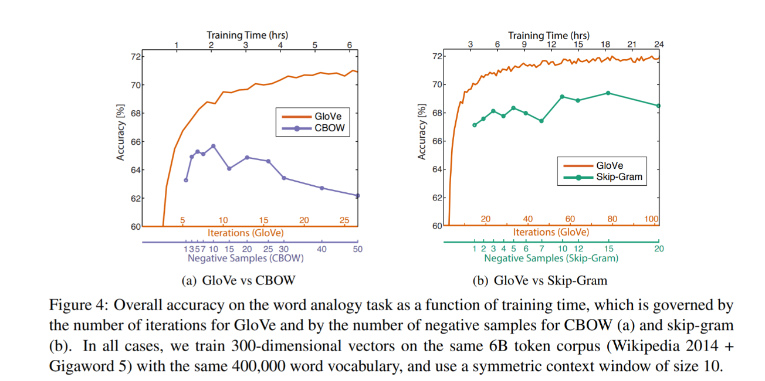
Glove
The objective
Pennington, J., Socher, R., & Manning, C. D. (2014, October). Glove: Global vectors for word representation. In Proceedings of the 2014 conference on empirical methods in natural language processing (EMNLP) (pp. 1532-1543).
Notes:
The main question now is how to implement an algorithm that generates word embeddings. There are multiple such algorithms. In this lab, you will work primarily with the Word2Vec algorithm that was invented by Mikolov et al. while at Google.
Word2Vec has two variants:
Continuous Bag-of-Words (CBOW): In this variant, using a number of context words, we try to predict the target word. Notice that by summing the embedding vectors we lose the word order, hence the BoW name.
Skip-Gram: In this variant we use the target word to predict each of the context words.
Note the words marked PAD – these are padding markers, signifying that there are no actual words here. Essentially, these are NULL markers for denoting empty context words.
A key property of the Word2Vec algorithm is that it is unsupervised (or more precisely, self-supervised). This means that it can be trained with huge corpora and generate very useful embedding vectors.

Slide 49
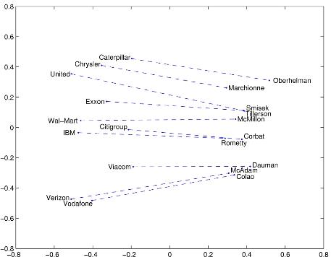
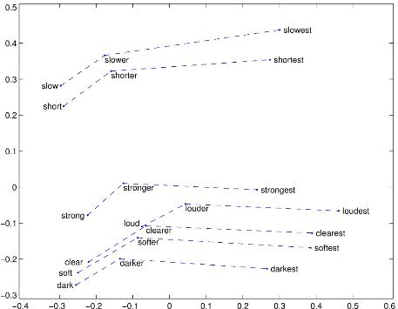
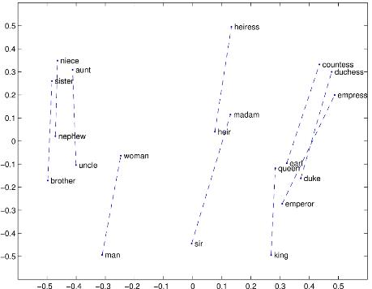
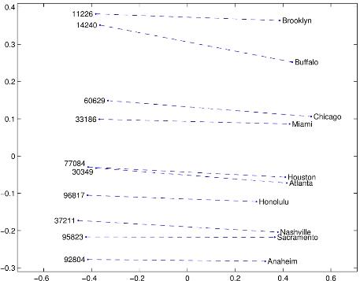
Glove
Properties
Company - CEO
Comparative - Superlative
Man - Woman
City – Zip Code
Pennington, J., Socher, R., & Manning, C. D. (2014, October). Glove: Global vectors for word representation. In Proceedings of the 2014 conference on empirical methods in natural language processing (EMNLP) (pp. 1532-1543).

Slide 50
Using the embeddings
Notes:
To put it in perspective

Slide 51
Machine Learning
In this class
Subset of Problem formulations
Machine Learning Algorithm
Text Pre-processing
Text Representation
Reweighting
Dimensionality Reduction
Vector Comparison
Text
Subset of
approaches
Subset of word representations

Slide 52
Classical approaches
Notes:
To put it in perspective

Slide 53

Classical Approaches
Very broad selection of tools

Slide 54
What about Feature Engineering?
Notes:
Are classical models able to solve complex problems without additional feature engineering? Distributional approaches only capture information about co-occurance

Slide 55
Deep Representation Learning

Slide 56
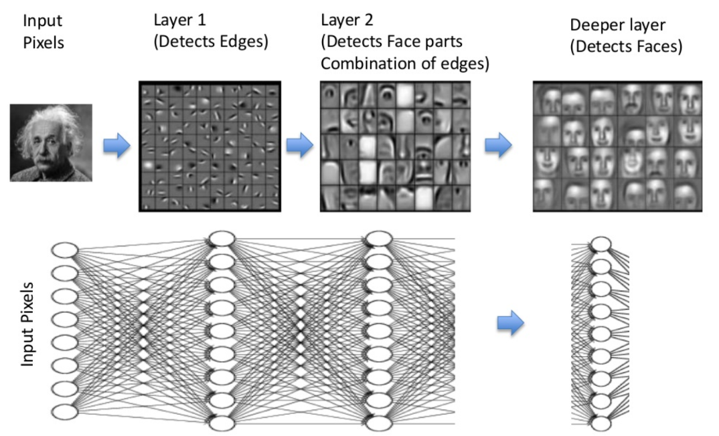
Deep Representation Learning
Beyond distributional hypothesis

Slide 57
Part 1: Machine Learning in NLP
Lecture
What is NLP?
Why Machine Learning?
Text Representations
Dimensionality Reduction
Embeddings
RNNs
“Attention is All You Need”
Lab
Transformer Architecture
Transformer Encoder
Transformer Decoder
Notes:
In this part, there will both a lecture and a hands-on lab section. In the lecture we’ll cover these topics. The goal of this lecture is to provide a good overview of NLP tasks, and the technologies to date (briefly) that have led us to the Transformer architecture, which was presented in the now-famous Google paper, “Attention is All You Need”.

Slide 58
Recurrent Neural Networks
Basic principles
y
y_{t-1}
y_{t}
y_{t+1}
y_{t+2}
s
s_{t-1}
s_{t}
s_{t+1}
s_{t+2}
x
x_{t-1}
x_{t}
x_{t+1}
x_{t+2}
Unrolling in Time
Notes:
In the previous lab, we encountered Fully-Connected (FC) neural networks. We would either go forward (from layer i to i+1) when propagating information or backwards (from layer i+1 to i) when propagating the error. At no point did we go in a horizontal direction inside the same layer.
Often we wish to use neural networks with sequence inputs or outputs: in other words, our input/output consists of different values at different timesteps. For that, we need to use recurrent neural networks (RNNs). As shown in the example here, at each timestep we have different inputs (the X’s) and different outputs (the y’s). Additionally, we have the state from the previous timestep (the S’s) as input (with the initial state typically being the 0 vector).
The algorithm used to train RNN’s is just the usual backpropagation, applied to subsequent timesteps and hence known as Backpropagation-Through-Time (BPTT).

Slide 59
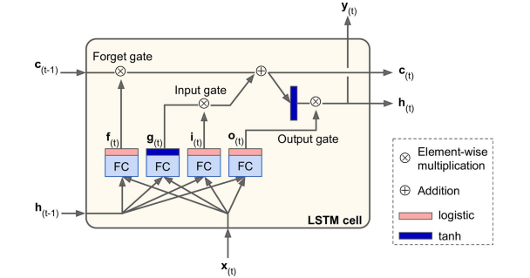
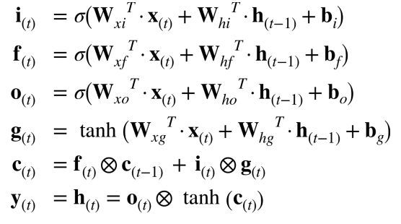
Long Short Term (LSTM) Cell
Addressing problems of stability
Notes:
Regular RNN’s are notoriously difficult to train. Because of the multiple timesteps, error gradients often tend to either shrink (‘vanish’) or grow (‘explode’) exponentially. This means that vanilla RNNs have difficulty with long sequences such as the ones we need for dealing with long text sequences.
A modification to the standard RNN is the Long Short-Term Memory (LSTM) cell, which overcomes many of the issues just mentioned. Essentially, it is a set of multiple neurons known as gates along with a memory cell. At each timestep, the cell receives input (x) along with the cell contents (c) and hidden state (h) from the previous timestep. The gates have the following functions:
Forget gate – what parts of the memory cell should be ‘forgotten’
Input gate – what parts of the input should be applied to the memory cell
Output gate - what parts of the memory cell should be exposed in the output of the cell
The new hidden state and memory cell state are then propagated to the next time step. The parameters are learned as usual using BPTT.

Slide 60
CNNs
Notes:
To put it in perspective

Slide 61
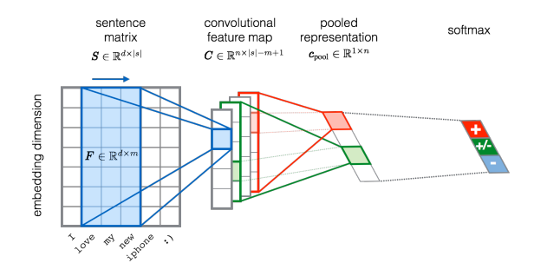
Convolutional Neural Networks
Basic principles
Severyn, Aliaksei, and Alessandro Moschitti. "Unitn: Training deep convolutional neural network for twitter sentiment classification." Proceedings of the 9th international workshop on semantic evaluation (SemEval 2015). 2015.

Slide 62
Attention
Notes:
To put it in perspective

Slide 63
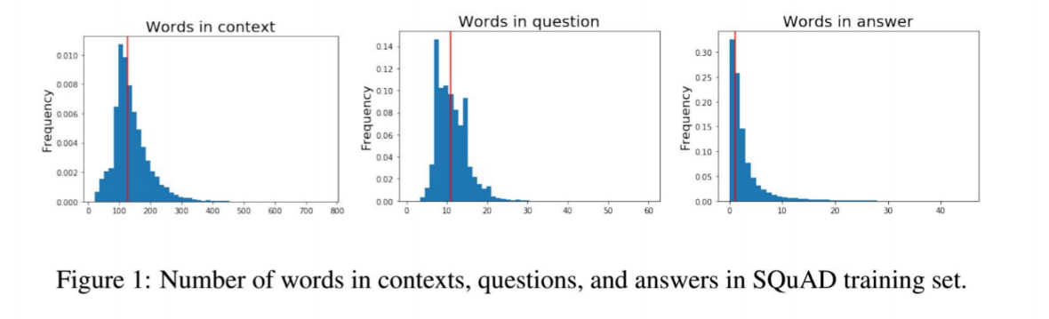
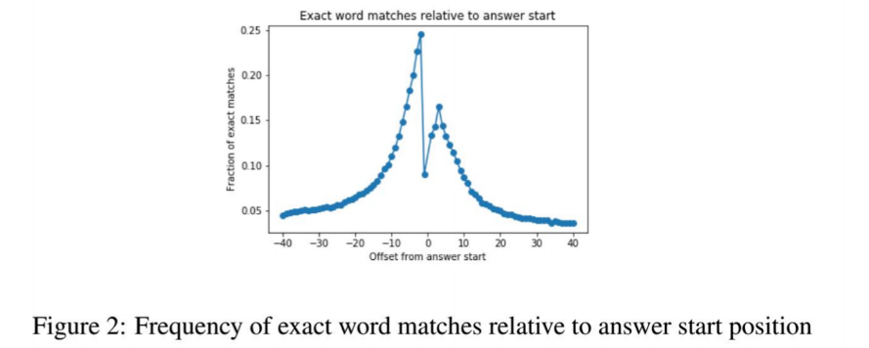
What about Long sequences?
The challenge illustrated with SQuAD
The impact of attention mechanism on Question Answering performance

Slide 64
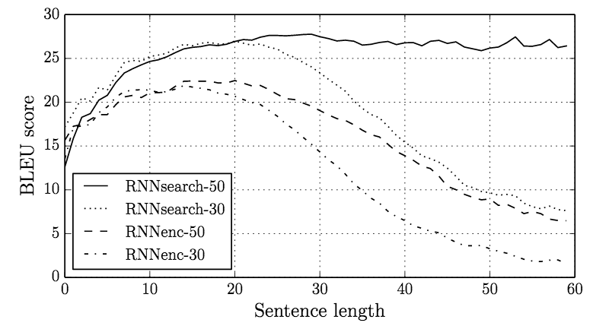
What about Long sequences?
The challenge
Bahdanau, D., Cho, K., & Bengio, Y. (2014). Neural machine translation by jointly learning to align and translate. arXiv preprint arXiv:1409.0473.

Slide 65
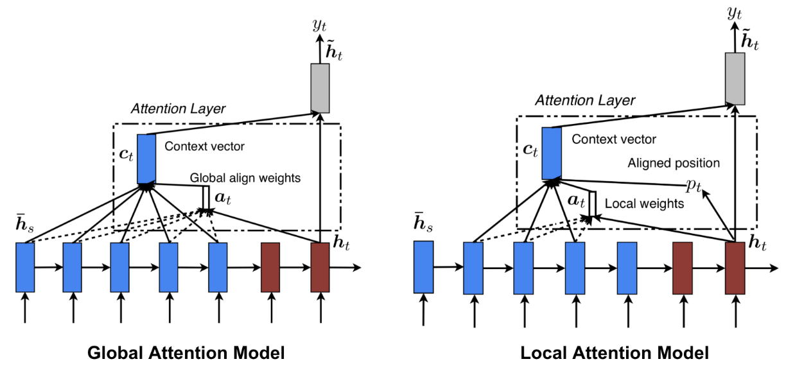
attention
The mechanism
Bahdanau, D., Cho, K., & Bengio, Y. (2014). Neural machine translation by jointly learning to align and translate. arXiv preprint arXiv:1409.0473.

Slide 66
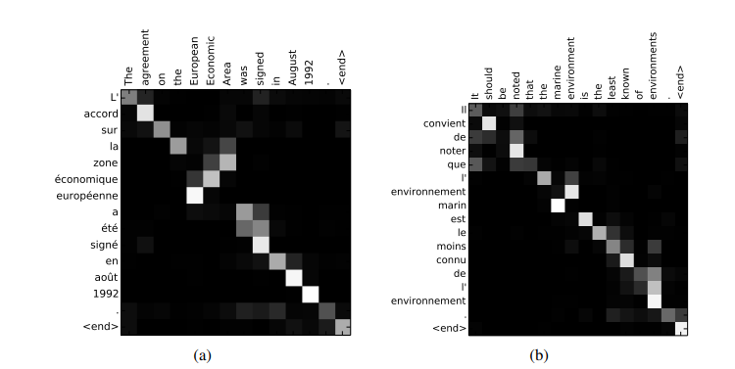
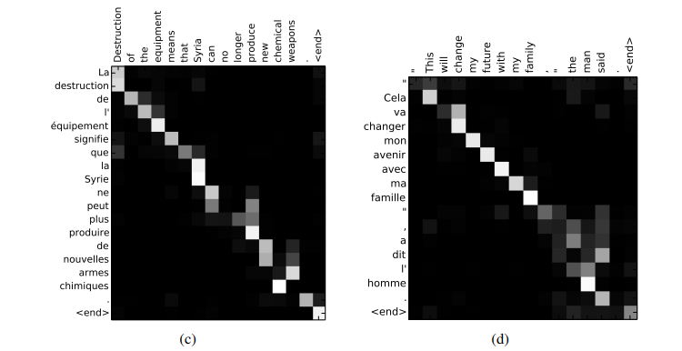
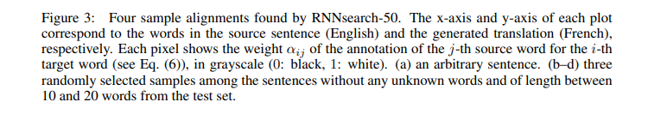
attention
The mechanism
Bahdanau, D., Cho, K., & Bengio, Y. (2014). Neural machine translation by jointly learning to align and translate. arXiv preprint arXiv:1409.0473.

Slide 67
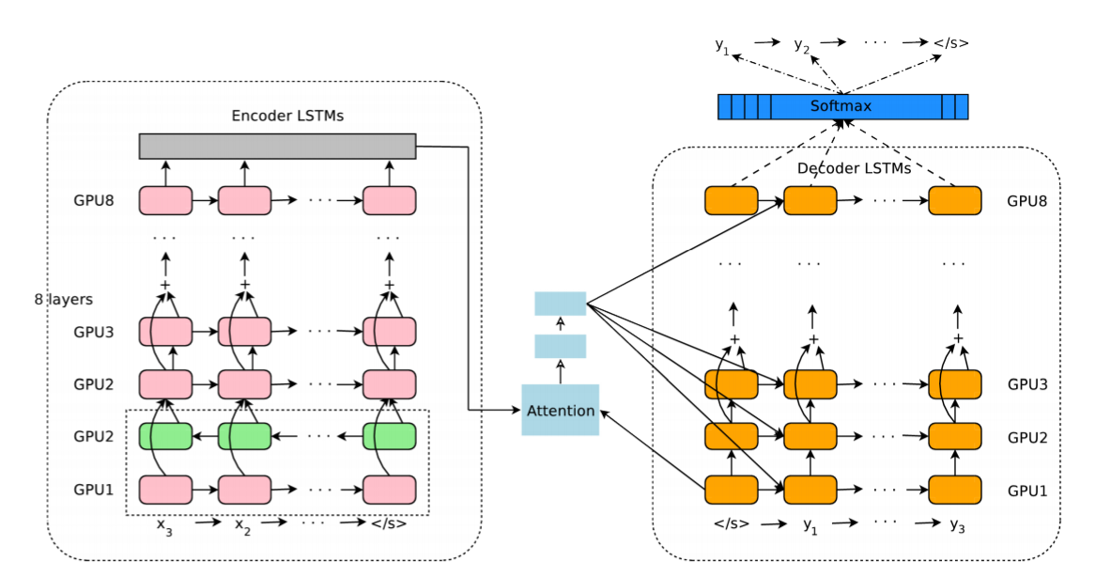
attention
Examples
Wu, Y., Schuster, M., Chen, Z., Le, Q. V., Norouzi, M., Macherey, W., ... & Klingner, J. (2016). Google's neural machine translation system: Bridging the gap between human and machine translation. arXiv preprint arXiv:1609.08144.

Slide 68
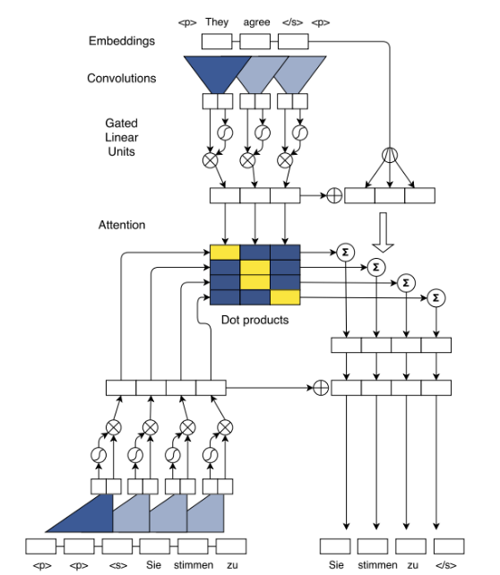
attention
Examples
Ott, M., Edunov, S., Baevski, A., Fan, A., Gross, S., Ng, N., ... & Auli, M. (2019). fairseq: A fast, extensible toolkit for sequence modeling. arXiv preprint arXiv:1904.01038.

Slide 69
Part 1: Machine Learning in NLP
Lecture
What is NLP?
Why Machine Learning?
Text Representations
Dimensionality Reduction
Embeddings
RNNs
“Attention is All You Need”
Lab
Transformer Architecture
Transformer Encoder
Transformer Decoder
Notes:
In this part, there will both a lecture and a hands-on lab section. In the lecture we’ll cover these topics. The goal of this lecture is to provide a good overview of NLP tasks, and the technologies to date (briefly) that have led us to the Transformer architecture, which was presented in the now-famous Google paper, “Attention is All You Need”.

Slide 70
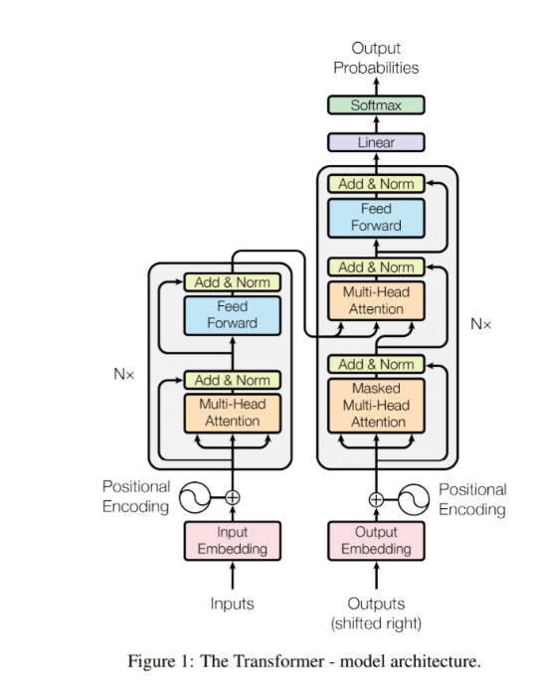
Attention is all you need
Design
Vaswani, A., Shazeer, N., Parmar, N., Uszkoreit, J., Jones, L., Gomez, A. N., ... & Polosukhin, I. (2017). Attention is all you need. In Advances in neural information processing systems (pp. 5998-6008).

Slide 71
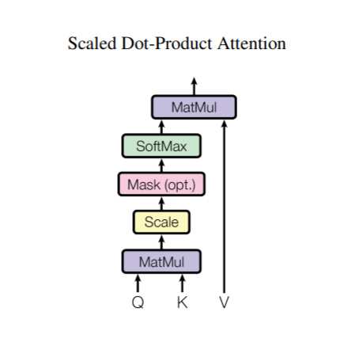
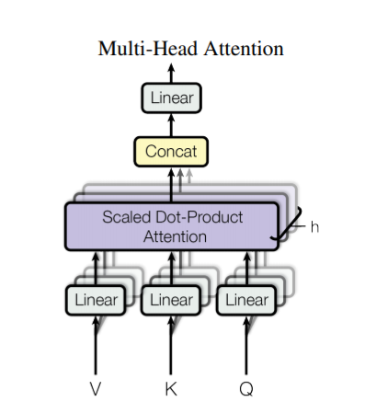
Attention is all you need
Design
Vaswani, A., Shazeer, N., Parmar, N., Uszkoreit, J., Jones, L., Gomez, A. N., ... & Polosukhin, I. (2017). Attention is all you need. In Advances in neural information processing systems (pp. 5998-6008).

Slide 72
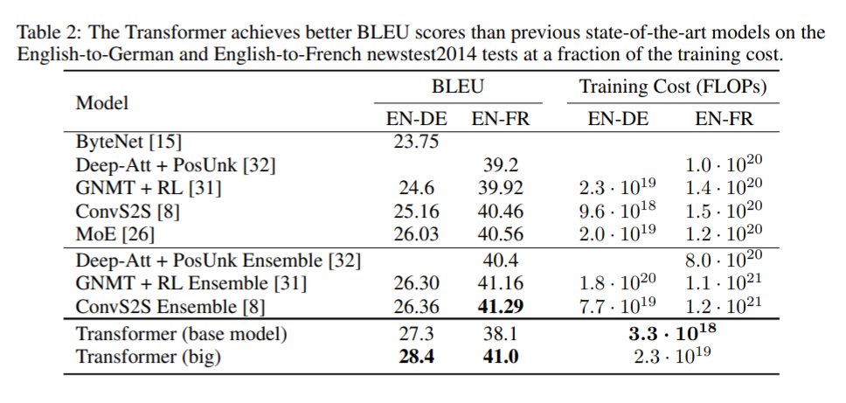
Attention is all you need
Not a breakthrough in itself
Vaswani, A., Shazeer, N., Parmar, N., Uszkoreit, J., Jones, L., Gomez, A. N., ... & Polosukhin, I. (2017). Attention is all you need. In Advances in neural information processing systems (pp. 5998-6008).

Slide 73
Attention is all you need
But …
“ … the Transformer can be trained significantly faster than architectures based on recurrent or convolutional layers.”
Vaswani, A., Shazeer, N., Parmar, N., Uszkoreit, J., Jones, L., Gomez, A. N., ... & Polosukhin, I. (2017). Attention is all you need. In Advances in neural information processing systems (pp. 5998-6008).

Slide 74
Neural Embeddings
Notes:
To put it in perspective

Slide 75
feature reuse
The opportunity

Slide 76
It was difficult to reuse NLP embeddings
Notes:
To put it in perspective

Slide 77
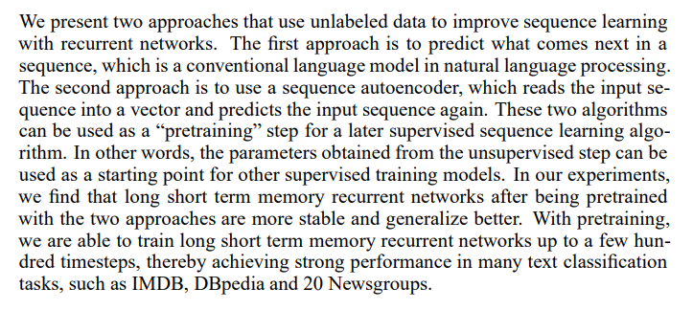
Semi-Supervised Sequence Learning
More complex representations
Dai, A. M., & Le, Q. V. (2015). Semi-supervised sequence learning. In Advances in neural information processing systems (pp. 3079-3087).

Slide 78
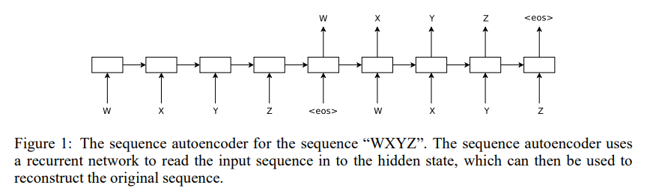
Semi-Supervised Sequence Learning
More complex representations
Dai, A. M., & Le, Q. V. (2015). Semi-supervised sequence learning. In Advances in neural information processing systems (pp. 3079-3087).

Slide 79
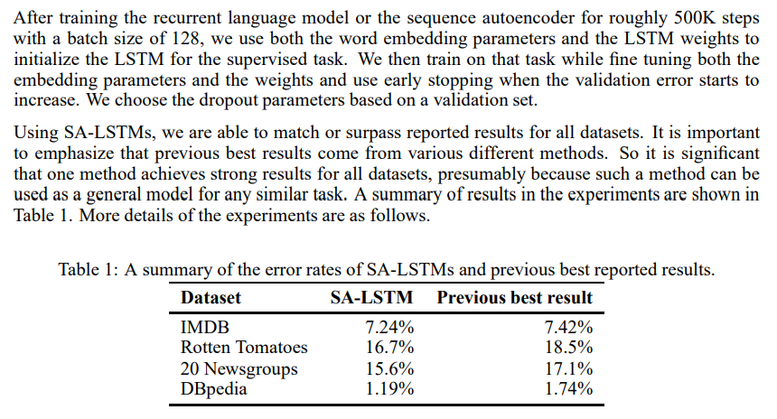
Semi-Supervised Sequence Learning
More complex representations
Dai, A. M., & Le, Q. V. (2015). Semi-supervised sequence learning. In Advances in neural information processing systems (pp. 3079-3087).

Slide 80
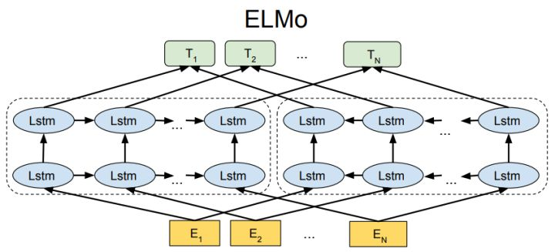
ELMo
Embeddings for Language Models
Peters, M. E., Neumann, M., Iyyer, M., Gardner, M., Clark, C., Lee, K., & Zettlemoyer, L. (2018). Deep contextualized word representations. arXiv preprint arXiv:1802.05365.

Slide 81
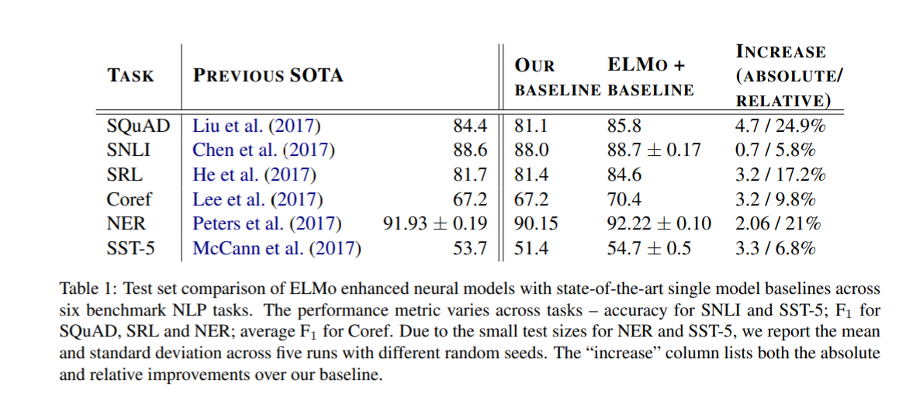
ELMo
Embeddings for Language Models
Peters, M. E., Neumann, M., Iyyer, M., Gardner, M., Clark, C., Lee, K., & Zettlemoyer, L. (2018). Deep contextualized word representations. arXiv preprint arXiv:1802.05365.

Slide 82
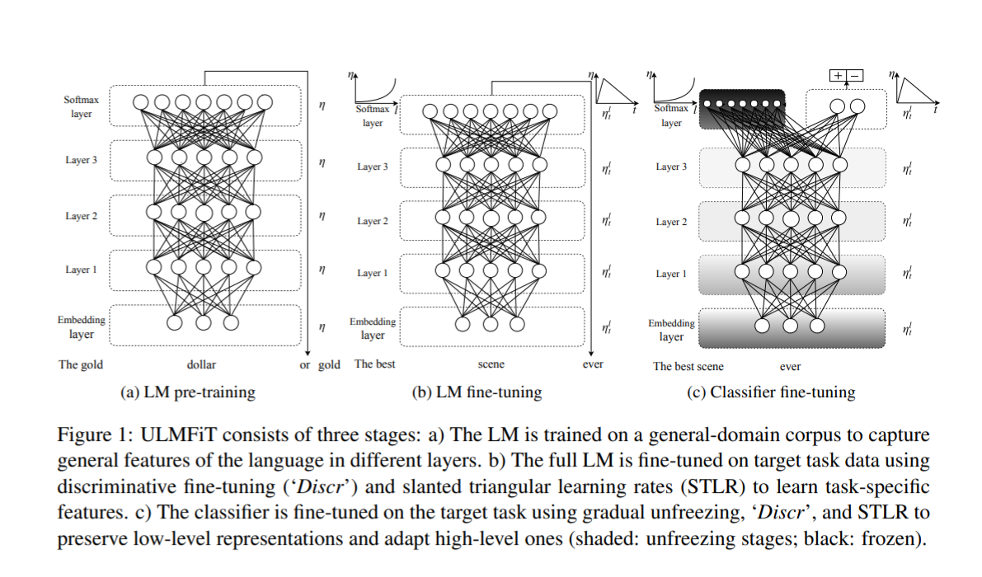
ULM-Fit
Universal Language Model Fine-Tuning for Text Classification
Howard, J., & Ruder, S. (2018). Universal language model fine-tuning for text classification. arXiv preprint arXiv:1801.06146.

Slide 83
difficulty
Not trivial to use and not universally applicable
Howard, J., & Ruder, S. (2018). Universal language model fine-tuning for text classification. arXiv preprint arXiv:1801.06146.
Peters, M. E., Neumann, M., Iyyer, M., Gardner, M., Clark, C., Lee, K., & Zettlemoyer, L. (2018). Deep contextualized word representations. arXiv preprint arXiv:1802.05365.

Slide 84
This Created a foundation for the new NLP Models (discussed in the next class)
Notes:
To put it in perspective

Slide 85
The Lab
Notes:
To put it in perspective

Slide 86
Attention is all you need
Deep dive into the transformer design
Vaswani, A., Shazeer, N., Parmar, N., Uszkoreit, J., Jones, L., Gomez, A. N., ... & Polosukhin, I. (2017). Attention is all you need. In Advances in neural information processing systems (pp. 5998-6008).

Slide 87
In The Next Class…
Notes:
To put it in perspective

Slide 88
Self-supervision, BERT, and beyond
Why did models start to work well? What does the future hold?
?

Slide 89
Part 1: Machine Learning in NLP
Lecture
What is NLP?
Why Machine Learning?
Text Representations
Dimensionality Reduction
Embeddings
RNNs
“Attention is All You Need”
Lab
Transformer Architecture
Transformer Encoder
Transformer Decoder
Notes:
Move on to the lab, which will cover these topics.

